Slide 1
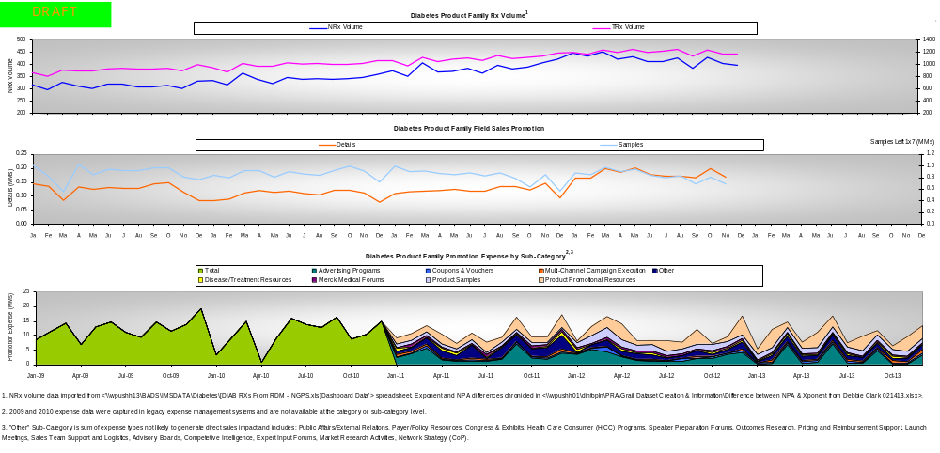
Diabetes Product Family Trends:
Rx Volume, Direct Selling Units, Promotion Spend
Notes:
Uptake dynamics around TZDs
Avandia CV warning in 2007 which created a fertile market for Januvia launch
Key events:
July 2009 onglyza 2nd in class DPP4 (Januvia has grown right through launches, looks uninterrupted, but confounded)
Feb 2010 victoza launched (GLP1, in market definition, but injectable, not considered a direct competitor)
Mar 2010 David Graham of FDA says avandia should be taken off the market (peak 1.4MM Rx/mo, then 300k Rx/mo, not at near zero – a couple of months of sideways and down, then down)...can discern this avandia event in Januvia trend
Dec 2010 onglyza/metformin (combaglyze)...combaglyze uptake was slow at first, put force behind it in January (looks a lot like XR, maybe a little bit better)
May 2011 trejenga/lynaglyptin (DPP4) ... extraordinarily slow uptake (access seems to be the main barrier, largely undifferentiated, spins that a little better than the liver)...offering 50% - 60% discounts (had impact on our rates in commercial plans but not on volume)
Aug 2011 ... 2nd TZD event, the actos label change (bladder cancer warning)...we accelerated investment in promo/direct sales messaging (coming into 2012 roaring along as a result) .... Largely played out 6-9 months later (switching from actos ramps up during this period and then ramps back down to pre-event levels)
Nov 2011 ... Juvisync launch (probably opened some doors, something new) ... But now expectations are $2MM/year-ish
Feb 2012:
1 Janumet XR
2 genta/duetto (tragenta/metformin)
3 bydureon (byetta)...anecdotally, some practices may go from metformin to injectable, but most practices go to 2nd line oral before injectable
Aug 2012 actos off patent (was in a rapid decline, went generic, still declining, but may slow decline - $4/mo) 1.5MM Rx/mo now at 600k (92% generic)
82% of market is generic (was 72% generic at launch)
Expected events in next 12 months
DPP4 Aloglyptin approved in January, expected launch in June (largely undifferentiated, maybe small efficacy downside, not a huge threat)
SGLT2, first expected in April (invokana ... J&J) ... This class plucked the Januvia development team out of Merck and shows almost twice as efficacious vs. Januvia at the highest dose (studied in a third line setting...patient had to be already have used SUs for X # of years)...SUs burn out pancreas beta cells... (other places to shoot at this product, essentially you dump glucose into urine, along with that comes higher risk of UTI, genital infections)...and an LDL increase seen in patients (not insignificant...CV outcomes trial used interim data to help filing...what’s in the label remains to be seen...trial is called “CANVAS”) (PDUFA date last week of March)...message testing now (by end of year combo with metformin is expected)...biggest threat may be in 2014
3 more GLP1s, 2 more SGLTs in 2014 and beyond
June 2013 CV outcomes trial for SAVER-TIMI onglyza trial, and if that shows any cardio-protective effect, may claim that’s a class effect, so this could be a Januvia upside
Januvia has a similar trial for end of 14 (called TECOS)

